Slide 1
Linear regression
Hung-Hsuan Chen
Adapted from Alexander Ihler (UCI) and Tony R. Martinez (BYU)

Slide 2
Parametric supervised learning
Notation
Features x
Targets y
Predictions ŷ
Parameters θ (to be learned)
Learning algorithm
Change θ
Improve performance
Program (“Learner”)
Characterized by
some “parameters” θ
Procedure (using θ)
that outputs a prediction
Training data
(examples)
Features
Feedback /
Target values
Score performance
(“cost function”)

Slide 3
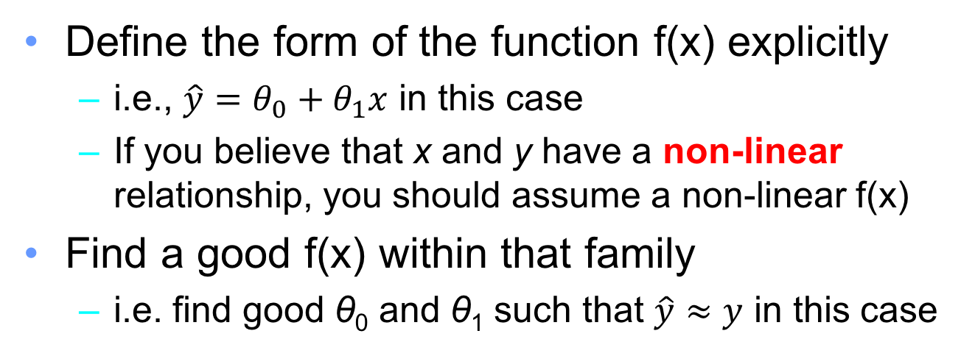
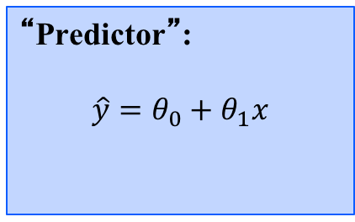
Linear regression
y
dependent
variable
(output)
“Predictor”:
$$\hat{y}=θ_{0}+θ_{1}x$$
x – independent variable (input)
Define the form of the function f(x) explicitly
i.e., $\hat{y}=θ_{0}+θ_{1}x$ in this case
If you believe that x and y have a non-linear relationship, you should assume a non-linear f(x)
Find a good f(x) within that family
i.e. find good θ₀ and θ₁ such that $\hat{y}≈y$ in this case

Slide 4
Quiz: which one should be an error measurement?
y
y
x
x

Slide 5



Measuring error
Error or “residual”
Observation
Prediction
0
0
20

Slide 6
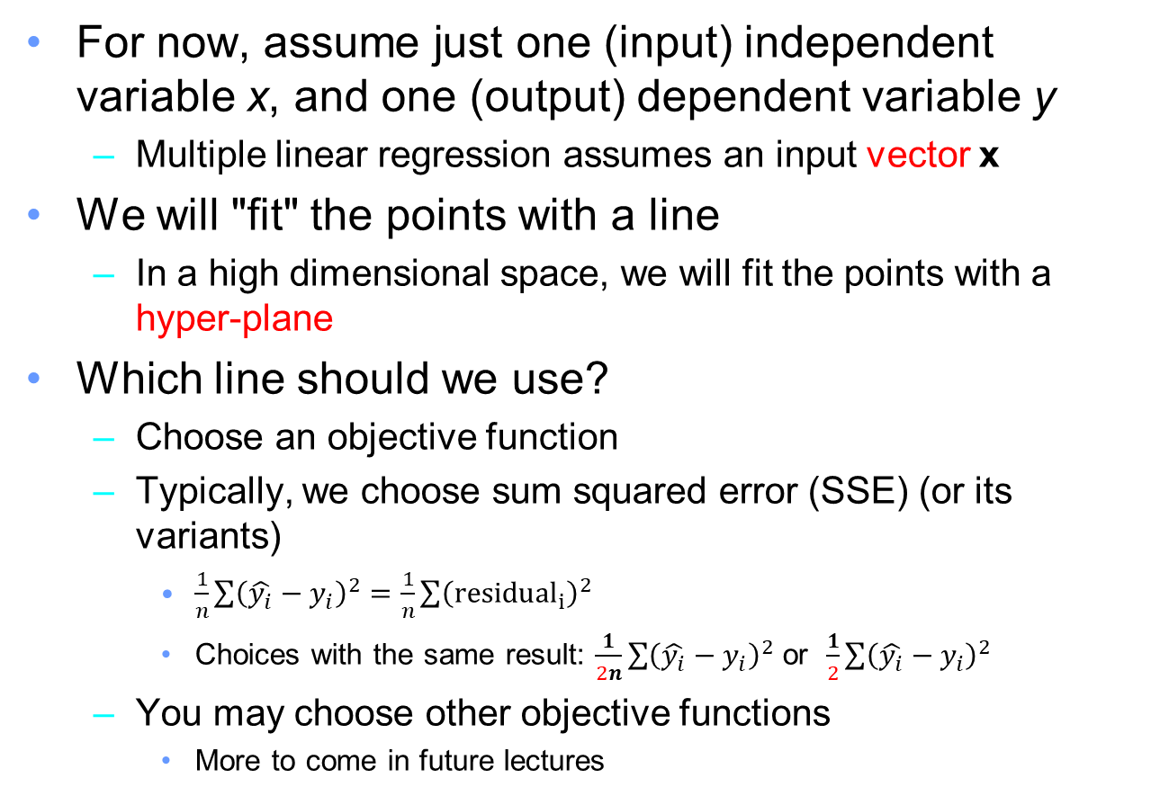
Simple linear regression
For now, assume just one (input) independent variable x, and one (output) dependent variable y
Multiple linear regression assumes an input vector x
We will "fit" the points with a line
In a high dimensional space, we will fit the points with a hyper-plane
Which line should we use?
Choose an objective function
Typically, we choose sum squared error (SSE) (or its variants)
$\frac{1}{n}\sum{{\left(\hat{y_{i}}−y_{i}\right)}^{2}}=\frac{1}{n}\sum{{\left(residu{al}_{i}\right)}^{2}}$
Choices with the same result: $\frac{1}{2n}\sum{{\left(\hat{y_{i}}−y_{i}\right)}^{2}}$ or $\frac{1}{2}\sum{{\left(\hat{y_{i}}−y_{i}\right)}^{2}}$
You may choose other objective functions
More to come in future lectures

Slide 7
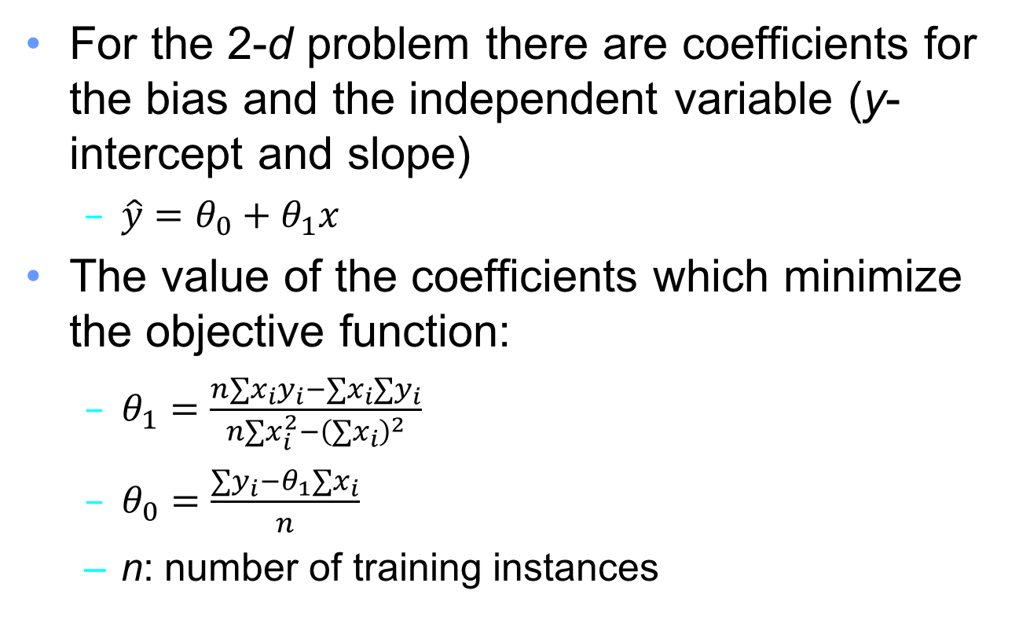
How to “learn” the parameters?
For the 2-d problem there are coefficients for the bias and the independent variable (y-intercept and slope)
$\hat{y}=θ_{0}+θ_{1}x$
The value of the coefficients which minimize the objective function:
$θ_{1}=\frac{n∑x_{i}y_{i}−∑x_{i}∑y_{i}}{n∑x_{i}^{2}−{\left(∑x_{i}\right)}^{2}}$
$θ_{0}=\frac{∑y_{i}−θ_{1}∑x_{i}}{n}$
n: number of training instances

Slide 8
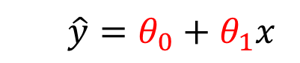

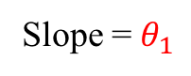
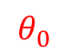
Visualzing $θ_{0}$ and $θ_{1}$
Slope = $θ_{1}$
y
$$θ_{0}$$
x
$$\hat{y}=θ_{0}+θ_{1}x$$

Slide 9
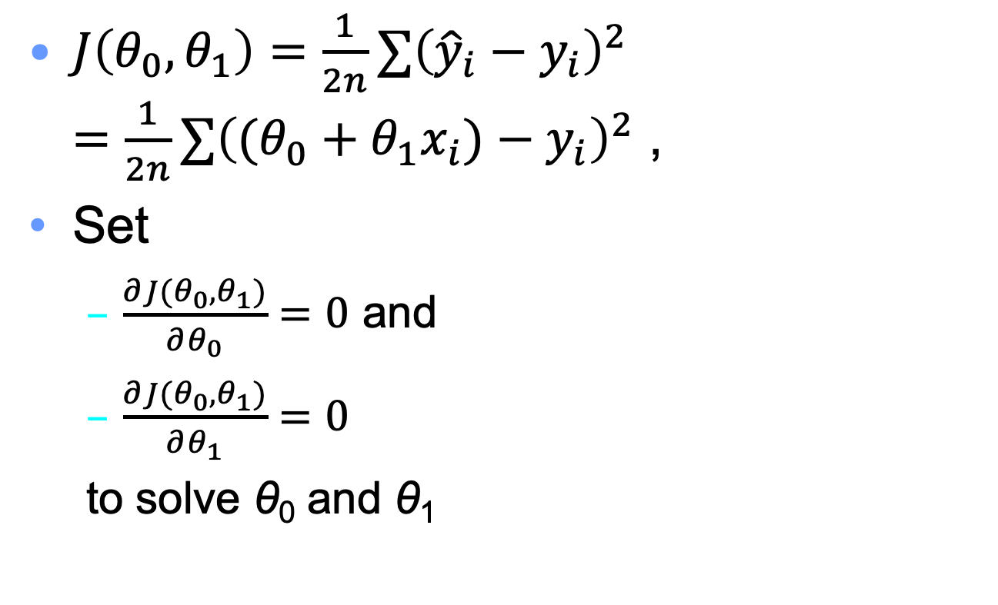
How to derive the value of the coefficients?
$J\left(θ_{0},θ_{1}\right)=\frac{1}{2n}∑{\left({\hat{y}}_{i}−y_{i}\right)}^{2}$ $=\frac{1}{2n}∑{\left((θ_{0}+θ_{1}x_{i})−y_{i}\right)}^{2}$ ,
Set
$\frac{∂J(θ_{0}, θ_{1})}{∂θ_{0}}=0$ and
$\frac{∂J(θ_{0}, θ_{1})}{∂θ_{1}}=0$
to solve θ₀ and θ₁

Slide 10
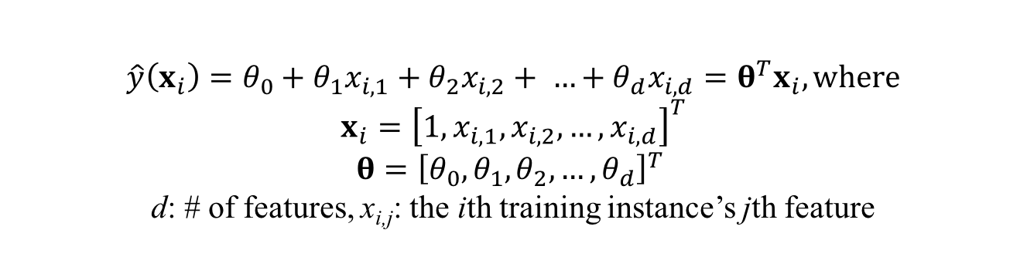
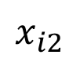
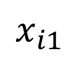
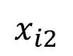
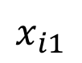
More dimensions?
26
26
y
24
y
24
22
22
20
20
30
30
20
40
40
$$x_{i1}$$
30
$$x_{i1}$$
$$x_{i2}$$
20
$$x_{i2}$$
30
10
20
10
20
0
10
0
10
0
0
$$\hat{y}\left(x_{i}\right)=θ_{0}+θ_{1}x_{i,1}+θ_{2}x_{i,2}+ …+θ_{d}x_{i,d}=θ^{T}x_{i}, where$$
$$x_{i}={\left[1,x_{i,1},x_{i,2}, …,x_{i,d}\right]}^{T}$$
$$θ={\left[θ_{0}, θ_{1},θ_{2}, …, θ_{d}\right]}^{T}$$
d: # of features, x_{i,j}: the ith training instance’s jth feature

Slide 11
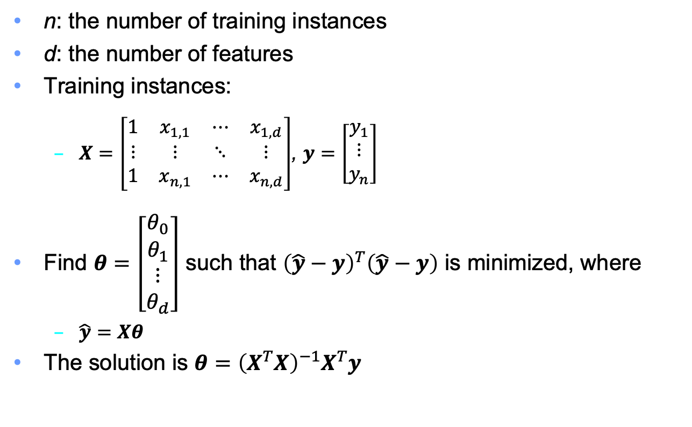
Multiple linear regression
n: the number of training instances
d: the number of features
Training instances:
$X=\left[\begin{matrix}1 & x_{1,1} & ⋯ & x_{1,d} \\ ⋮ & ⋮ & ⋱ & ⋮ \\ 1 & x_{n,1} & ⋯ & x_{n,d}\end{matrix}\right]$, $y=\left[\begin{matrix}y_{1} \\ ⋮ \\ y_{n}\end{matrix}\right]$
Find $θ=\left[\begin{matrix}\begin{aligned}θ_{0} \\ θ_{1}\end{aligned} \\ ⋮ \\ θ_{d}\end{matrix}\right]$ such that ${\left(\hat{y}−y\right)}^{T}\left(\hat{y}−y\right)$ is minimized, where
$\hat{y}=Xθ$
The solution is $θ={\left(X^{T}X\right)}^{−1}X^{T}y$

Slide 12
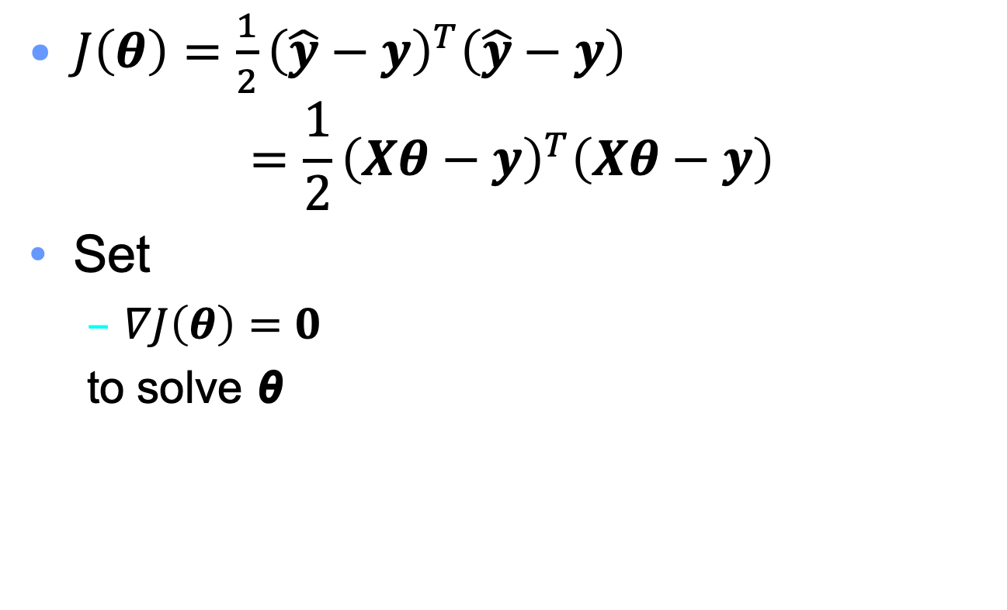
How to derive the value of the coefficient vector?
$J\left(θ\right)=\frac{1}{2}{\left(\hat{y}−y\right)}^{T}\left(\hat{y}−y\right)$ $=\frac{1}{2}{\left(Xθ−y\right)}^{T}\left(Xθ−y\right)$
Set
$∇J\left(θ\right)=0$
to solve θ

Slide 13
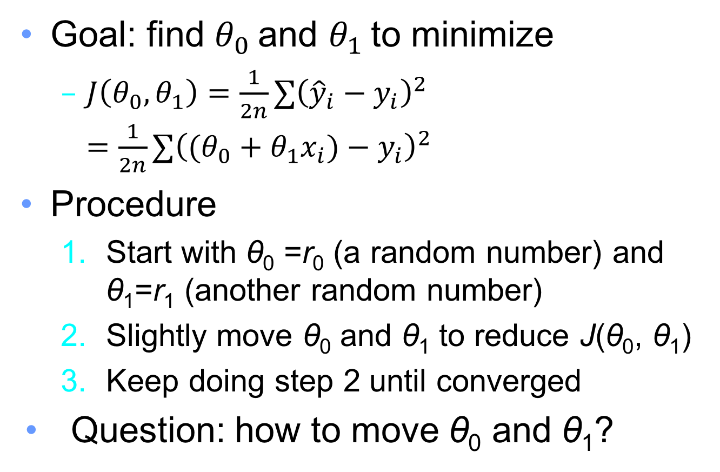
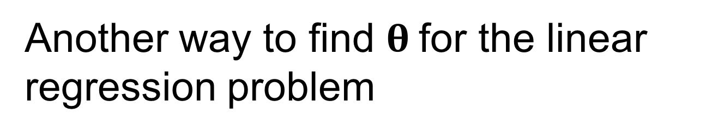
Another way to find $θ$for the linear regression problem
Goal: find $θ_{0}$and $θ_{1}$to minimize
$J\left(θ_{0},θ_{1}\right)=\frac{1}{2n}∑{\left({\hat{y}}_{i}−y_{i}\right)}^{2}$ $=\frac{1}{2n}∑{\left((θ_{0}+θ_{1}x_{i})−y_{i}\right)}^{2}$
Procedure
Start with θ₀ =r₀ (a random number) and θ₁=r₁ (another random number)
Slightly move θ₀ and θ₁ to reduce J(θ₀, θ₁)
Keep doing step 2 until converged
Question: how to move θ₀ and θ₁?

Slide 14
Plotting the objective function (3D and contour plots)
Keep moving ”downward” to reach the minimum

Slide 15
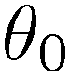
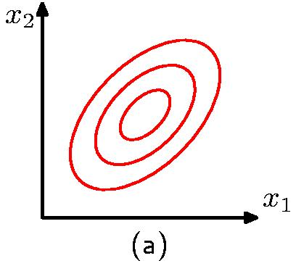
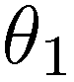
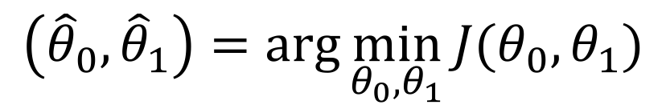
Finding good parameters
Want to find parameters which minimize our error…
Think of a cost “surface”: error residual for that θ…
J(θ₀, θ₁)
$$\left({\hat{θ}}_{0},{\hat{θ}}_{1}\right)=arg\min_{θ_{0},θ_{1}}{J(θ_{0}, θ_{1})}$$

Slide 16
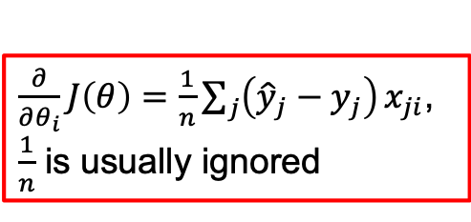
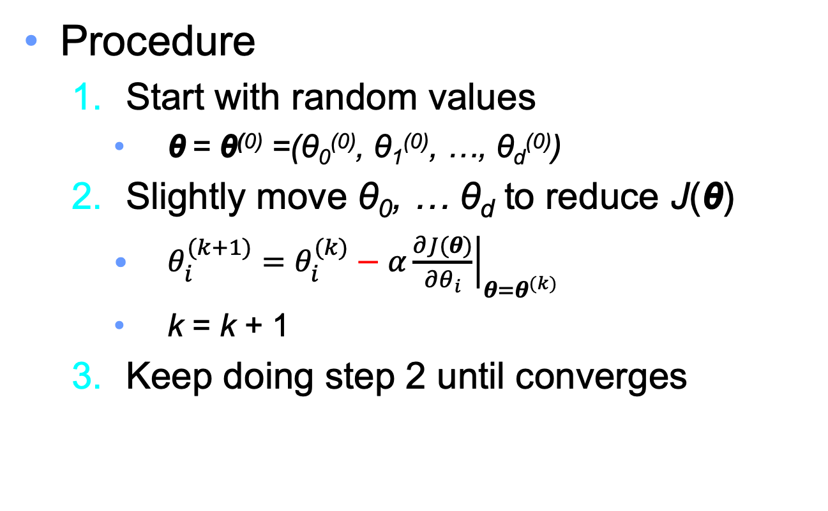
Gradient descent
Procedure
Start with random values
θ = θ⁽⁰⁾ =(θ₀⁽⁰⁾, θ₁⁽⁰⁾, …, θ_{d}⁽⁰⁾)
Slightly move θ₀, … θ_{d} to reduce J(θ)
$θ_{i}^{(k+1)}=θ_{i}^{(k)}−α{\left.\frac{∂J(θ)}{∂θ_{i}}\right|}_{θ=θ^{(k)}}$
k = k + 1
Keep doing step 2 until converges
α is a small positive number
$\frac{∂}{∂θ_{i}}J\left(θ\right)=\frac{1}{n}\sum_{j}{\left({\hat{y}}_{j}−y_{j}\right)}x_{ji}$, $\frac{1}{n}$ is usually ignored

Slide 17
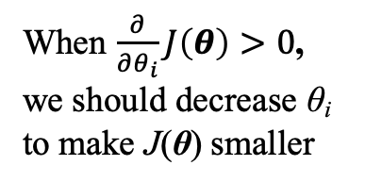
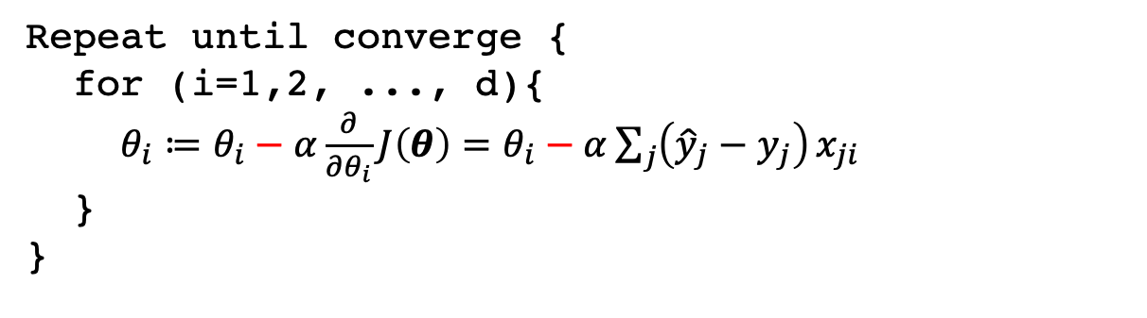
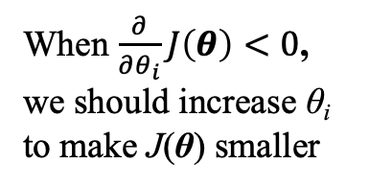
Why gradient descent work?
Repeat until converge {
for (i=1,2, ..., d){
$θ_{i}≔θ_{i}−α\frac{∂}{∂θ_{i}}J\left(θ\right)=θ_{i}−α\sum_{j}{\left({\hat{y}}_{j}−y_{j}\right)}x_{ji}$
}
}
J(θ)
When $\frac{∂}{∂θ_{i}}J\left(θ\right)>0$, we should decrease θ_{i} to make J(θ) smaller
When $\frac{∂}{∂θ_{i}}J\left(θ\right)<0$, we should increase θ_{i} to make J(θ) smaller
θ_{i}

Slide 18
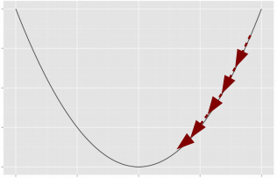
Gradient descent (one feature and two features)

Slide 19
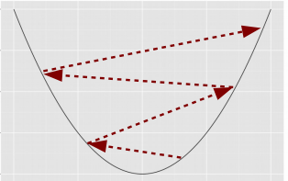
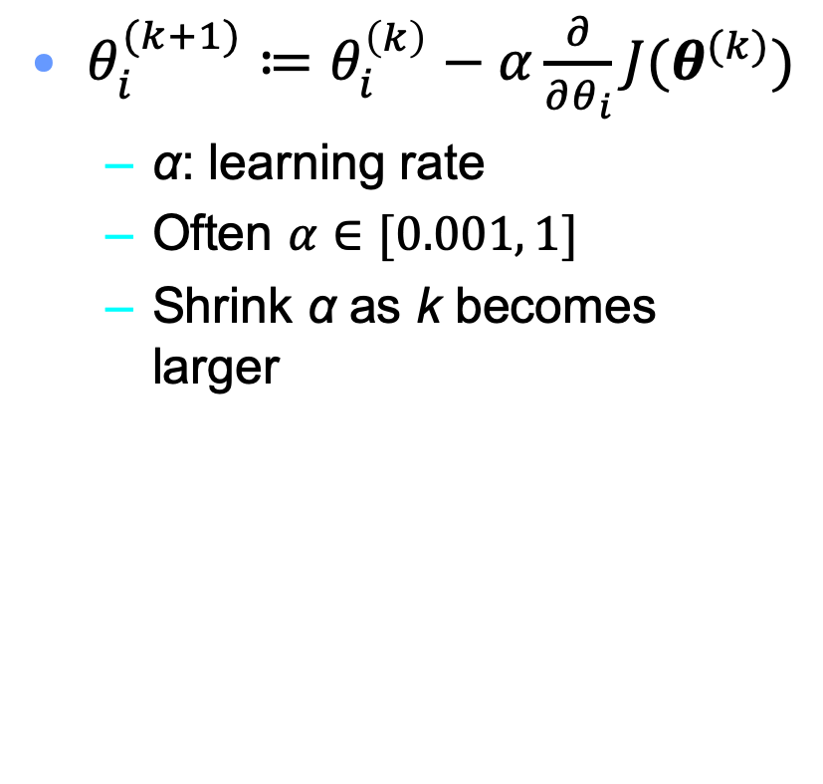
Overly large learning rate may not lead to converge
$θ_{i}^{(k+1)}≔θ_{i}^{\left(k\right)}−α\frac{∂}{∂θ_{i}}J(θ^{(k)})$
α: learning rate
Often $α∈[0.001, 1]$
Shrink α as k becomes larger

Slide 20
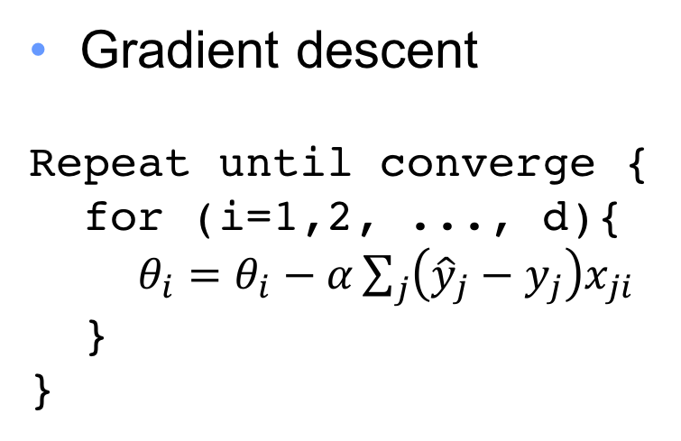
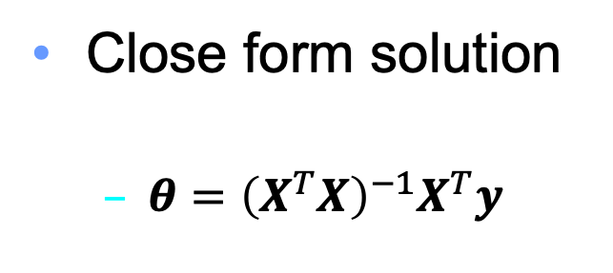
We now have two tools to solve linear regression problem
Close form solution
$θ={\left(X^{T}X\right)}^{−1}X^{T}y$
Gradient descent
Repeat until converge {
for (i=1,2, ..., d){
$θ_{i}=θ_{i}−α\sum_{j}{\left({\hat{y}}_{j}−y_{j}\right)x_{ji}}$
}
}
Which one should we use?

Slide 21
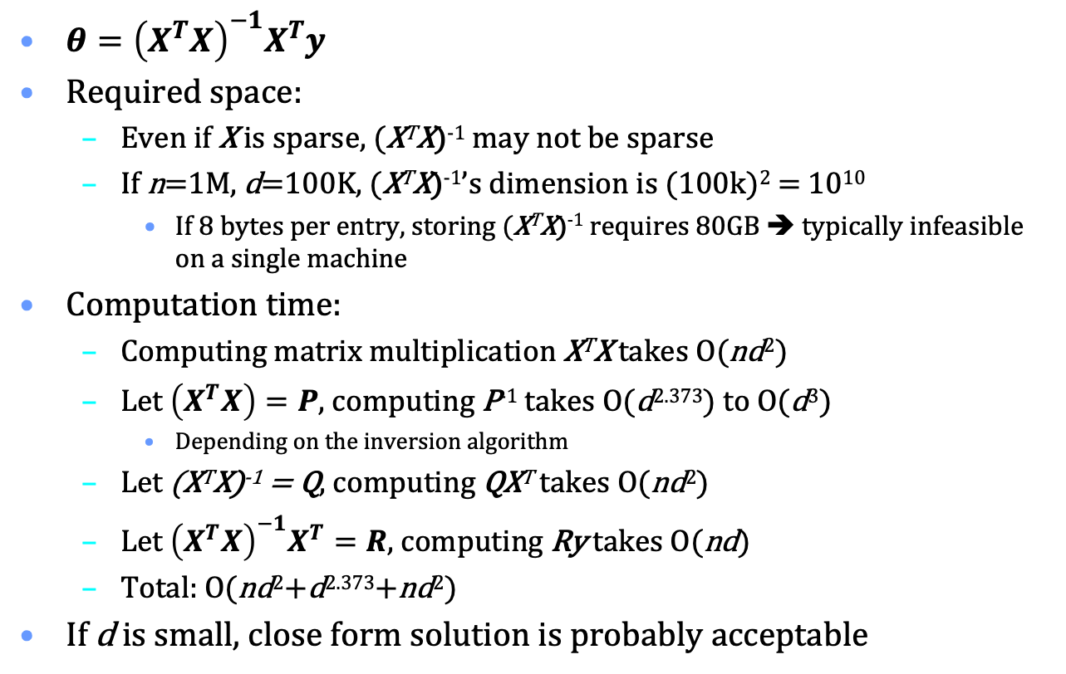
Consider using close form solution
$θ={\left(X^{T}X\right)}^{−1}X^{T}y$
Required space:
Even if X is sparse, (X^{T}X)⁻¹ may not be sparse
If n=1M, d=100K, (X^{T}X)⁻¹’s dimension is (100k)² = 10¹⁰
If 8 bytes per entry, storing (X^{T}X)⁻¹ requires 80GB ➔ typically infeasible on a single machine
Computation time:
Computing matrix multiplication X^{T}X takes O(nd²)
Let $\left(X^{T}X\right)=P$, computing P⁻¹ takes O(d^{2.373}) to O(d³)
Depending on the inversion algorithm
Let (X^{T}X)⁻¹ = Q, computing QX^{T} takes O(nd²)
Let ${\left(X^{T}X\right)}^{−1}X^{T}=R$, computing Ry takes O(nd)
Total: O(nd²+d^{2.373}+nd²)
If d is small, close form solution is probably acceptable

Slide 22
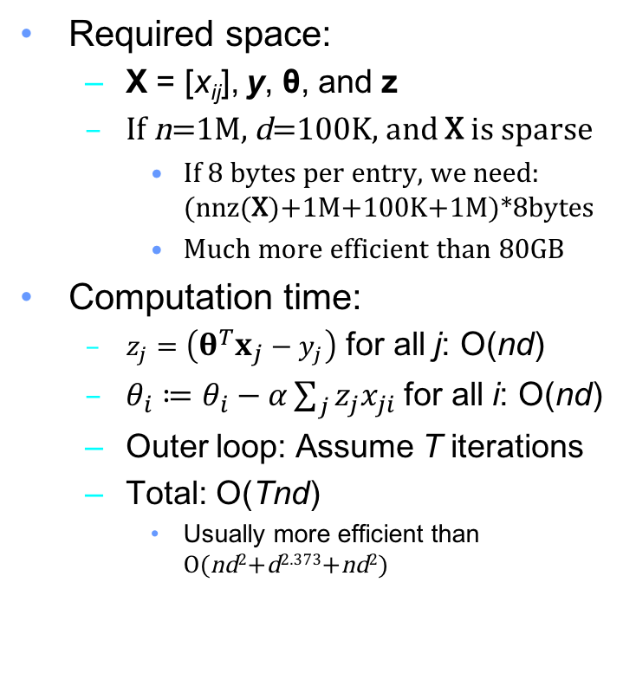
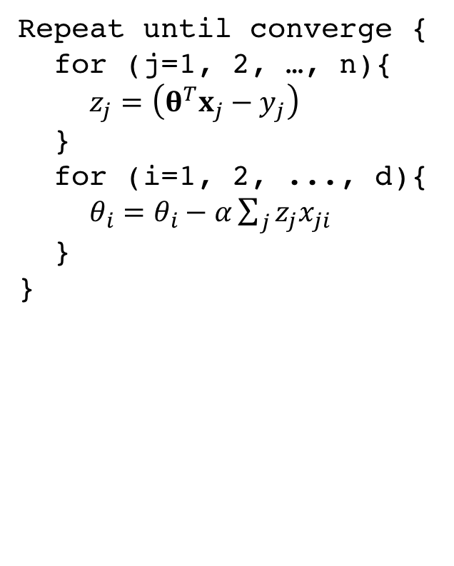
Consider using Gradient Descent
Repeat until converge {
for (j=1, 2, …, n){
$z_{j}=\left(θ^{T}x_{j}−y_{j}\right)$
}
for (i=1, 2, ..., d){
$θ_{i}=θ_{i}−α\sum_{j}{z_{j}x_{ji}}$
}
}
Required space:
X = [x_{ij}], y, θ, and z
If n=1M, d=100K, and X is sparse
If 8 bytes per entry, we need: (nnz(X)+1M+100K+1M)*8bytes
Much more efficient than 80GB
Computation time:
$z_{j}=\left(θ^{T}x_{j}−y_{j}\right)$ for all j: O(nd)
$θ_{i}≔θ_{i}−α\sum_{j}{z_{j}x_{ji}}$ for all i: O(nd)
Outer loop: Assume T iterations
Total: O(Tnd)
Usually more efficient than O(nd²+d^{2.373}+nd²)

Slide 23
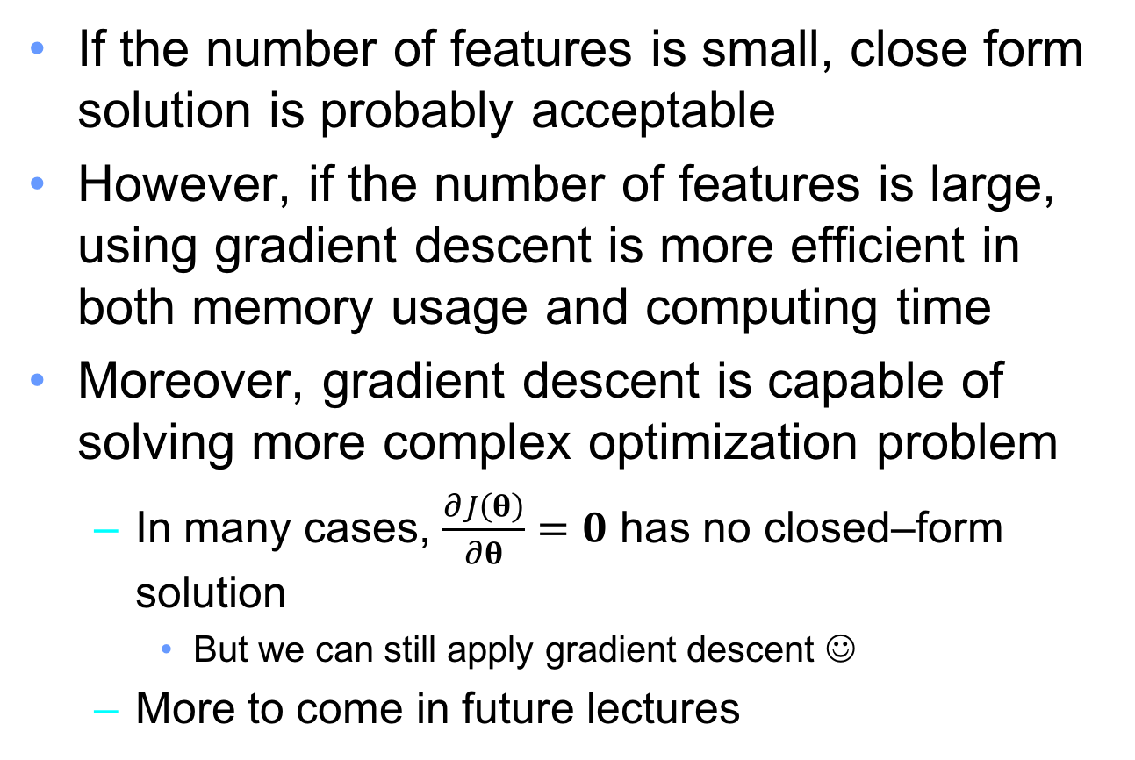
Close form vs gradient descent
If the number of features is small, close form solution is probably acceptable
However, if the number of features is large, using gradient descent is more efficient in both memory usage and computing time
Moreover, gradient descent is capable of solving more complex optimization problem
In many cases, $\frac{∂J\left(θ\right)}{∂θ}=0$ has no closed–form solution
But we can still apply gradient descent ☺
More to come in future lectures

Slide 24
Quiz
If the features are all categorical
Can you apply linear regression?
Can you apply decision tree?
Can you apply knn?
If all features are numerical, which one runs faster during “test” phase?
Linear regression? Decision tree? KNN?

Slide 25
When to stop updating?
Possible stopping criteria:
Improvement drops (e.g., < 0)
Reached small error
Achieved predefined # of iterations
No time to train anymore

Slide 26
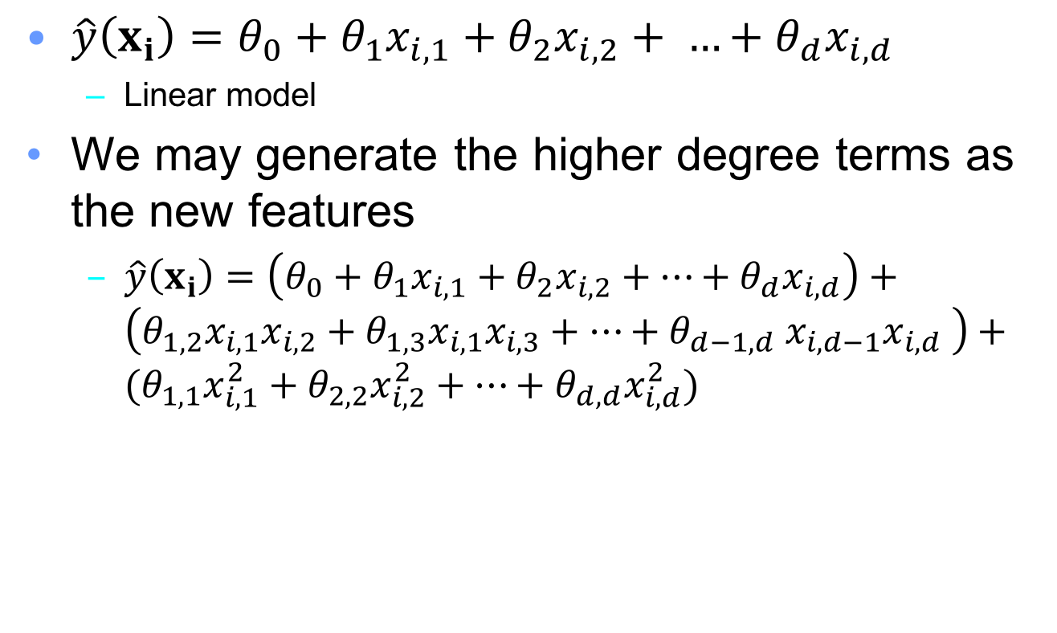
Fitting non-linear data to linear model
$\hat{y}\left(x_{i}\right)=θ_{0}+θ_{1}x_{i,1}+θ_{2}x_{i,2}+ …+θ_{d}x_{i,d}$
Linear model
We may generate the higher degree terms as the new features
$\hat{y}\left(x_{i}\right)=\left(θ_{0}+θ_{1}x_{i,1}+θ_{2}x_{i,2}+…+θ_{d}x_{i,d}\right)+$ $\left(θ_{1,2}x_{i,1}x_{i,2}+θ_{1,3}x_{i,1}x_{i,3}+…+θ_{d−1,d} x_{i,d−1}x_{i,d} \right)+$ $(θ_{1,1}x_{i,1}^{2}+θ_{2,2}x_{i,2}^{2}+…+θ_{d,d}x_{i,d}^{2})$

Slide 27
Overfitting
Overfitting occurs when a model captures idiosyncrasies of the input data, rather than generalizing
Too many parameters relative to the amount of training data
For example, an order-N polynomial can perfectly fit to N+1 data points

Slide 28
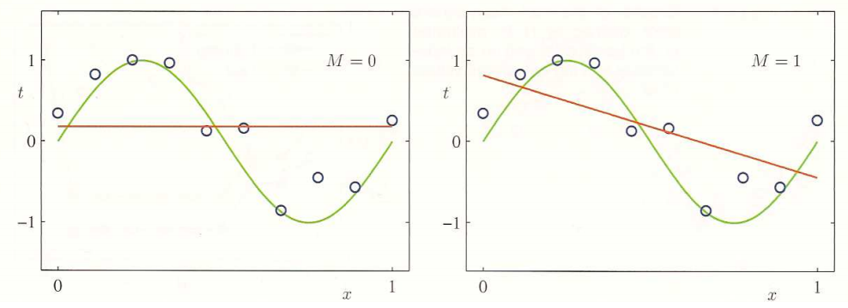

Target: $\sin\left(2πx\right)+noise$
d = 0
d = 1

Slide 29
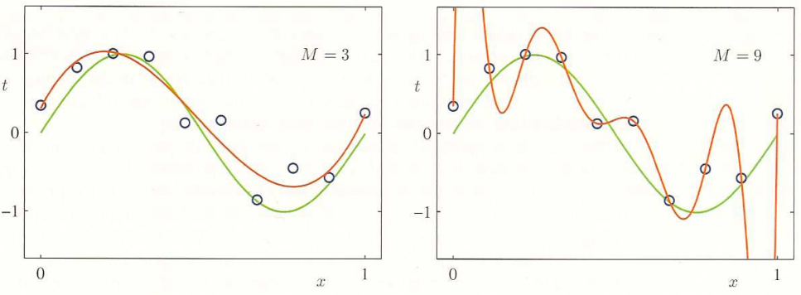
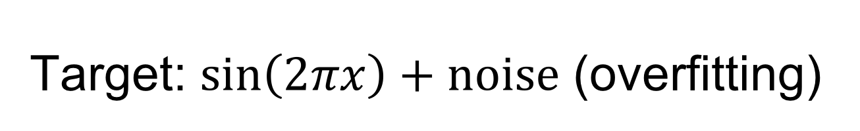
Target: $\sin\left(2πx\right)+noise$ (overfitting)
d = 3
d = 9

Slide 30
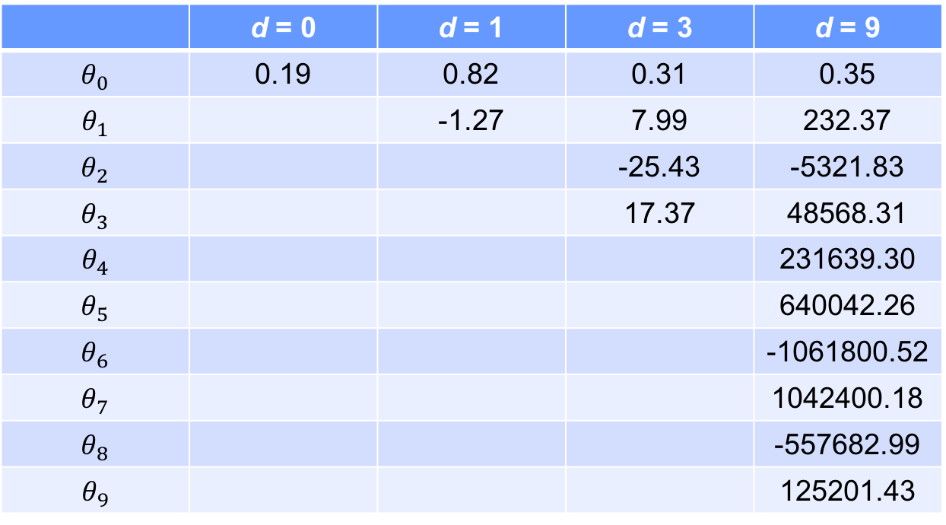
Observation
In the linear regression model, overfitting is characterized by large parameters
 | d = 0 | d = 1 | d = 3 | d = 9
$$θ_{0}$$ | 0.19 | 0.82 | 0.31 | 0.35
$$θ_{1}$$ |  | -1.27 | 7.99 | 232.37
$$θ_{2}$$ |  |  | -25.43 | -5321.83
$$θ_{3}$$ |  |  | 17.37 | 48568.31
$$θ_{4}$$ |  |  |  | 231639.30
$$θ_{5}$$ |  |  |  | 640042.26
$$θ_{6}$$ |  |  |  | -1061800.52
$$θ_{7}$$ |  |  |  | 1042400.18
$$θ_{8}$$ |  |  |  | -557682.99
$$θ_{9}$$ |  |  |  | 125201.43

Slide 31
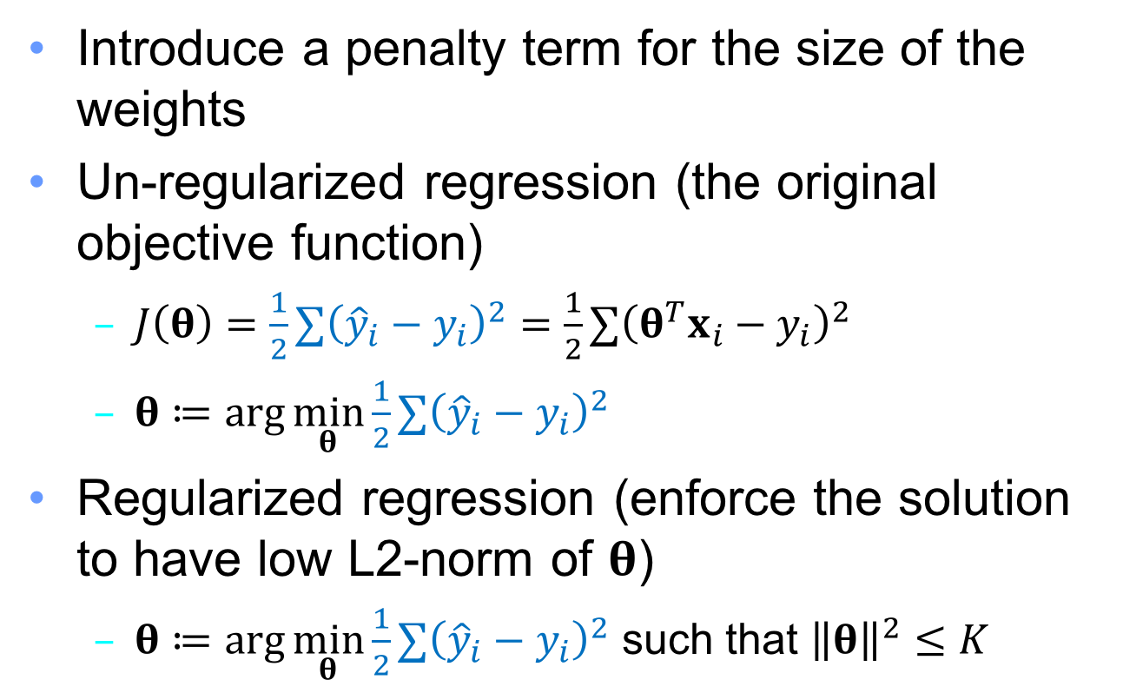
Regularization to avoid overfitting
Introduce a penalty term for the size of the weights
Un-regularized regression (the original objective function)
$J\left(θ\right)=\frac{1}{2}∑{\left({\hat{y}}_{i}−y_{i}\right)}^{2}=\frac{1}{2}∑{\left(θ^{T}x_{i}−y_{i}\right)}^{2}$
$θ≔\arg{\min_{θ}{\frac{1}{2}∑{\left({\hat{y}}_{i}−y_{i}\right)}^{2}}}$
Regularized regression (enforce the solution to have low L2-norm of $θ$)
$θ≔\arg{\min_{θ}{\frac{1}{2}∑{\left({\hat{y}}_{i}−y_{i}\right)}^{2}}}$ such that ${\left\|θ\right\|}^{2}≤K$

Slide 32
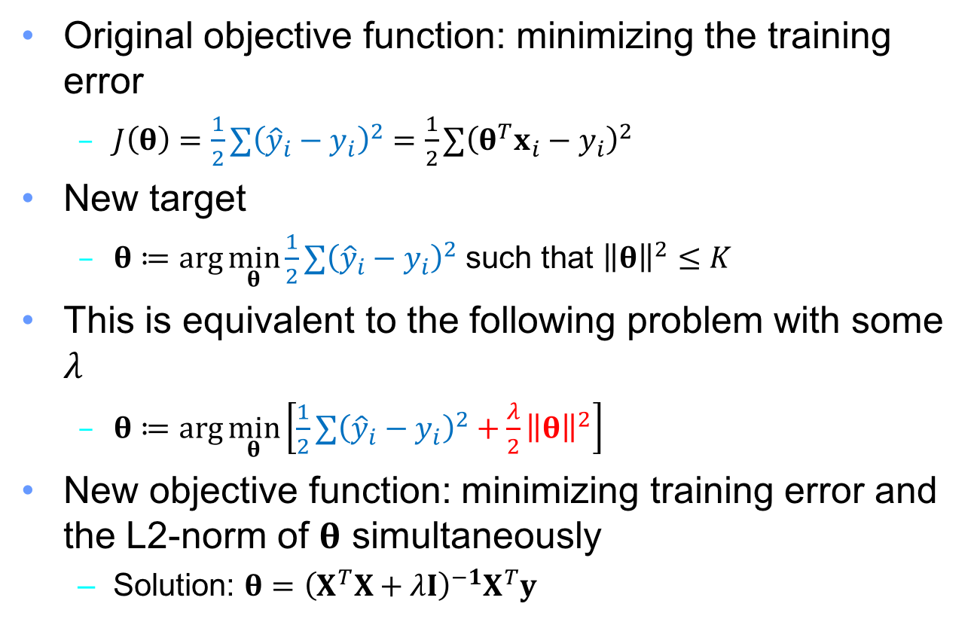
Regularization to avoid overfitting
Original objective function: minimizing the training error
$J\left(θ\right)=\frac{1}{2}∑{\left({\hat{y}}_{i}−y_{i}\right)}^{2}=\frac{1}{2}∑{\left(θ^{T}x_{i}−y_{i}\right)}^{2}$
New target
$θ≔\arg{\min_{θ}{\frac{1}{2}∑{\left({\hat{y}}_{i}−y_{i}\right)}^{2}}}$ such that ${\left\|θ\right\|}^{2}≤K$
This is equivalent to the following problem with some $λ$
$θ≔\arg{\min_{θ}\left[\frac{1}{2}∑{\left({\hat{y}}_{i}−y_{i}\right)}^{2}+\frac{λ}{2}{\left\|θ\right\|}^{2}\right]}$
New objective function: minimizing training error and the L2-norm of $θ$ simultaneously
Solution: $θ={\left(X^{T}X+λI\right)}^{−1}X^{T}y$

Slide 33
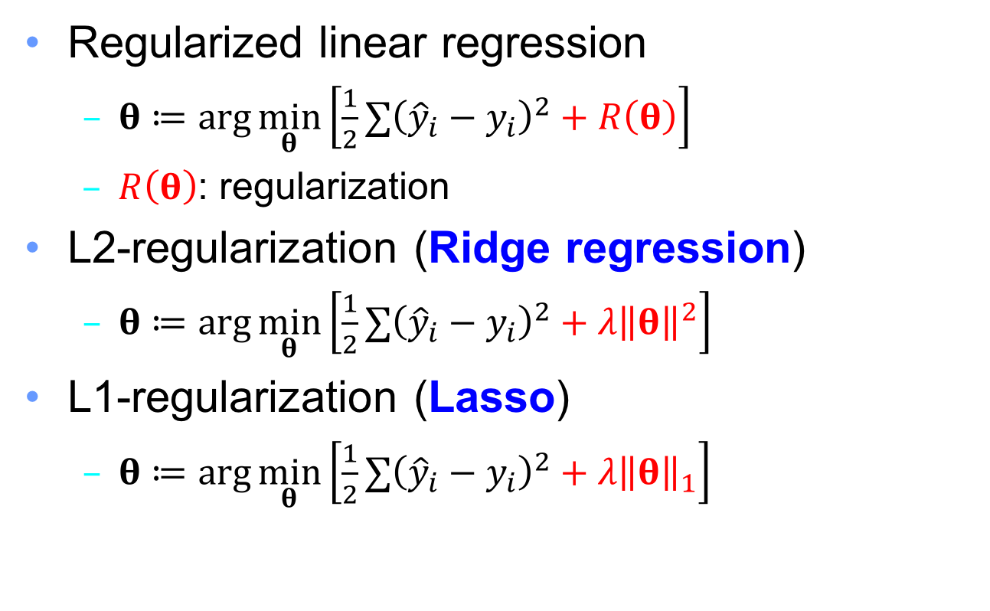
Regularized linear regression
Regularized linear regression
$θ≔\arg{\min_{θ}\left[\frac{1}{2}∑{\left({\hat{y}}_{i}−y_{i}\right)}^{2}+R\left(θ\right)\right]}$
$R\left(θ\right)$: regularization
L2-regularization (Ridge regression)
$θ≔\arg{\min_{θ}\left[\frac{1}{2}∑{\left({\hat{y}}_{i}−y_{i}\right)}^{2}+λ{\left\|θ\right\|}^{2}\right]}$
L1-regularization (Lasso)
$θ≔\arg{\min_{θ}\left[\frac{1}{2}∑{\left({\hat{y}}_{i}−y_{i}\right)}^{2}+λ{\left\|θ\right\|}_{1}\right]}$

Slide 34
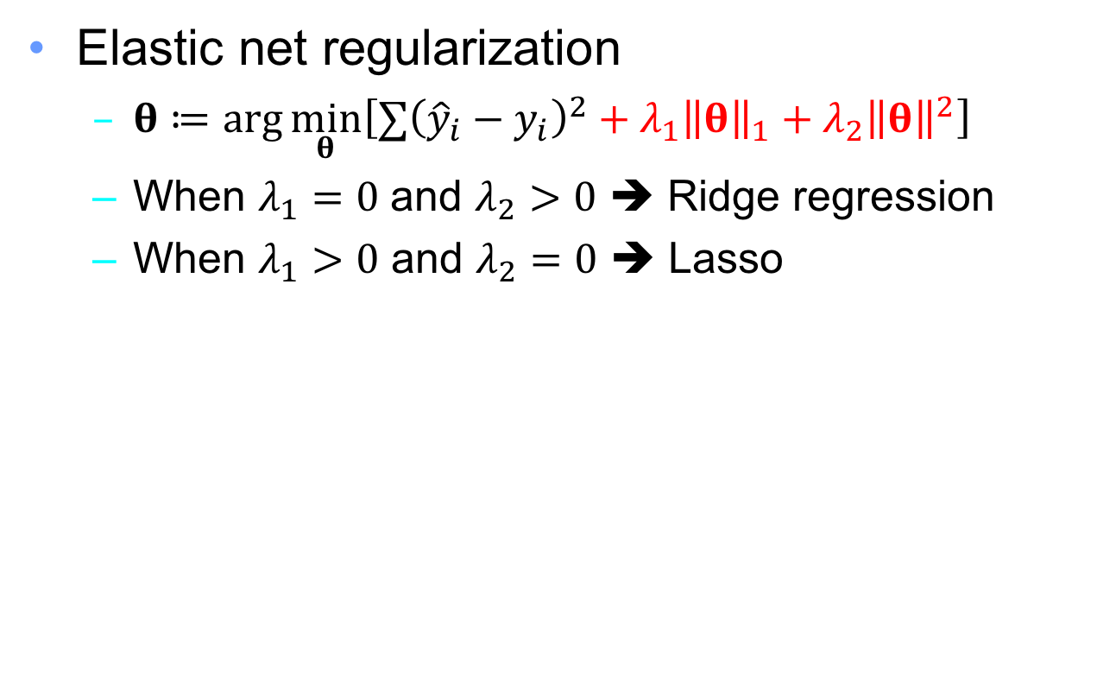
Combining Ridge and Lasso
Elastic net regularization
$θ≔\arg{\min_{θ}\left[∑{\left({\hat{y}}_{i}−y_{i}\right)}^{2}+λ_{1}{\left\|θ\right\|}_{1}+λ_{2}{\left\|θ\right\|}^{2}\right]}$
When $λ_{1}=0$ and $λ_{2}>0$ ➔ Ridge regression
When $λ_{1}>0$ and $λ_{2}=0$ ➔ Lasso

Slide 35
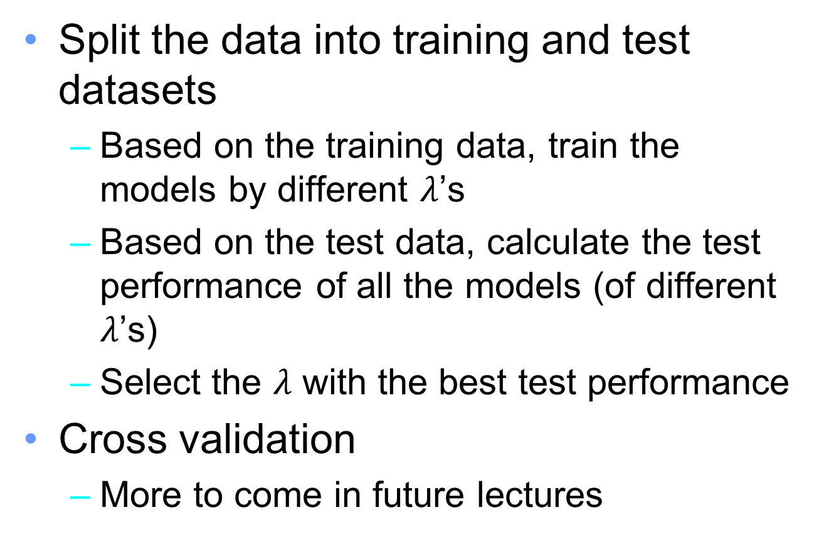

How to select $λ$?
Split the data into training and test datasets
Based on the training data, train the models by different $λ$’s
Based on the test data, calculate the test performance of all the models (of different $λ$’s)
Select the $λ$ with the best test performance
Cross validation
More to come in future lectures

Slide 36
Properties of Ridge and Lasso
Ridge
Good if many features have small/medium sized effects
Lasso
Good if only a few features with a medium/large effect

Slide 37
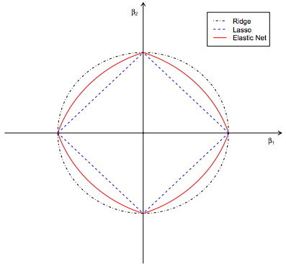
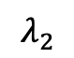
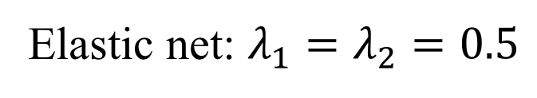
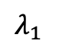
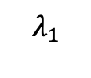


Geometry of Ridge, Lasso, and Elastic net
Elastic net: $λ_{1}=λ_{2}=0.5$
$$λ_{2}$$
$$θ_{2}$$
$$λ_{1}$$
$$θ_{1}$$
$$λ_{1}$$

Slide 38

Why Lasso zeros coefficients
RSS: $$∑{\left(θ^{T}x_{i}−y_{i}\right)}^{2}$$
θ₂
θ₂
$$\hat{θ}$$
$$\hat{θ}$$
$${\left\|θ\right\|}_{1}≤K$$
$${\left\|θ\right\|}^{2}≤K$$
θ₁
θ₁

Slide 39

Why Lasso zeros coefficients? – a numerical explanation
Ridge
$θ≔\arg{\min_{θ}\left[\frac{1}{2}∑{\left({\hat{y}}_{i}−y_{i}\right)}^{2}+λ{\left\|θ\right\|}^{2}\right]}$
Changing $θ_{j}$ from 2 to 1 reduces the cost by $λ\left(22−12\right)=3λ$
Changing $θ_{j}$ from 1 to 0 reduces the cost by $λ\left(12−02\right)=λ$
Lasso
$θ≔\arg{\min_{θ}\left[\frac{1}{2}∑{\left({\hat{y}}_{i}−y_{i}\right)}^{2}+λ{\left\|θ\right\|}_{1}\right]}$
Changing $θ_{j}$ from from 2 to 1 reduces the cost by $λ\left(2−1\right)=λ$
Changing $θ_{j}$ from from 1 to 0 reduces the cost by $λ\left(1−0\right)=λ$
➔ Ridge tends to shrink large coefficients to smaller ones, but not to shrink small coefficients to zero

Slide 40


Generalize the regularization term
$θ≔\arg{\min_{θ}\left[\frac{1}{2}∑{\left({\hat{y}}_{i}−y_{i}\right)}^{2}+λ{\left\|θ\right\|}^{q}\right]}$
$$q≥0$$
q=1: Lasso
q=2: Ridge regression
A smaller q tends to shrink the coefficients

Slide 41

Gradient descent for ridge regression
Gradient descent (GD)
$θ^{(k+1)}≔θ^{\left(k\right)}−α∇J{\left(θ^{\left(k\right)}\right)}^{T}$
Ridge regression
$J\left(θ\right)=\frac{1}{2}{\left(\hat{y}−y\right)}^{T}\left(\hat{y}−y\right)+\frac{λ}{2}{\left\|θ\right\|}^{2}$ $=\frac{1}{2}{\left(Xθ−y\right)}^{T}\left(Xθ−y\right)+\frac{λ}{2}θ^{T}θ$
$∇J\left(θ\right)={\left(Xθ−y\right)}^{T}X+λθ^{T}$
$∇J{\left(θ\right)}^{T}=X^{T}\left(Xθ−y\right)+λθ$

Slide 42

Gradient descent for ridge regression (pseudo code)
1 k := 0
2 Initialize $θ^{(k)}$
3 while not converge:
4 $g≔X^{T}\left(Xθ^{\left(k\right)}−y\right)+λθ^{(k)}$
5 $θ^{(k+1)}≔θ^{(k)}−αg$
6 k := k+1

Slide 43

Convex function
Convex function: let function $f:X→R$
$∀x_{1},x_{2}∈X,∀t∈\left[0,1\right]$ $f\left(tx_{1}+\left(1−t\right)x_{2}\right)≤tf\left(x_{1}\right)+\left(1−t\right)f\left(x_{2}\right)$
Local minimum is global minimum
The least-square linear regression objective and the Ridge regression objective are both convex functions
Gradient descent will find the unique minimum (or very close, depending on the step size $α$

Slide 44







Effect of the step size $α$
Small $α$: Long computation time
Large $α$: may not reach the minimum
$$J(θ)$$
$$J(θ)$$
$$θ_{i}^{(k)}$$
$$θ_{i}^{(k)}$$
A common practice
Gradually shrink the value of the step size

Slide 45


Stochastic gradient descent (SGD) – motivation
In GD, the gradient is computed by
$g≔X^{T}\left(Xθ^{\left(k\right)}−y\right)+λθ^{(k)}$
The entire training set is examined at each step
Very slow when the # of training instances is large!

Slide 46


Stochastic gradient descent
Optimize one example at a time
1 k := 0
2 Initialize $θ^{(k)}$
3 while not converge:
4 $g≔x_{i}\left(x_{i}^{T}θ^{\left(k\right)}−y_{i}\right)+λθ^{(k)}$
5 $θ^{(k+1)}≔θ^{(k)}−αg$
6 k := k+1
7 Get next data instance i
Only one training instance is examined at each step
Why does SGD work?
$E\left(∇J_{i}\left(θ\right)\right)=\frac{1}{n}∑∇J_{i}\left(θ\right)= ∇J\left(θ\right)$

Slide 47

Gradient descent (GD) vs stochastic gradient descent (SGD)
# steps
GD: fewer steps
SGD: more steps
Computation of each step
GD: look through all the training instances
SGD: look only one training instance

Slide 48
Pros and cons of SGD
Pros
When the training data is large with some (near) redundant instances, SGD is usually much faster to converge than GD
Supports online learning
Cons
Tends to bouncing around the minimum

Slide 49

Mini-batch gradient descent
Optimize few examples at a time
1 k := 0
2 Initialize $θ^{(k)}$
3 while not converge:
4 $g≔x_{i:j}^{T}\left(x_{i:j}θ^{\left(k\right)}−y_{i:j}\right)+λθ^{(k)}$
5 $θ^{(k+1)}≔θ^{(k)}−αg$
6 k := k+1
7 Get next batch (i,i+1,…,j)
Training instances (i, i+1, …, j) are examined

Slide 50
Gradient descent/stochastic gradient descent/mini-batch gradient descent
All of them iteratively update the parameters such that the target function gradually becomes smaller
If we have n training instances
(Batch) gradient descent: every parameter update requires seeing all training instances once
Stochastic gradient descent: every parameter update requires seeing one of n training instances
Mini-batch: every parameter update requires seeing b training instances (if batch size = b)

Slide 51

Locally weighted linear regression
Linear regression
Method
Assume $\hat{y}=θ_{0}+θ_{1}x$
Find $θ_{0}$ and $θ_{1}$ to minimize $\sum_{i}{{\left(y_{i}−\hat{y_{i}}\right)}^{2}}$
Given a new instance $x^{∗}$, we predict the corresponding $y^{∗}$ as $θ_{0}+θ_{1}x^{∗}$
Once training finished, we get $θ_{0}$ and $θ_{1}$, and training data can be removed
However, can only model linear relationship
Locally weighted linear regression
Model the ”nonlinear” data by weighting errors differently

Slide 52

Locally weighted linear regression (1/3)
Method
Given a new instance $x^{∗}$, we define the weight of each training error by
$w_{i}=\exp\left(−\frac{{\left(x_{i}−x^{∗}\right)}^{2}}{2σ^{2}}\right)$
$σ$ is a hyperparameter; we set to 1 for simplicity
If $x_{i}≈x^{∗}, w_{i}≈1$
If $x_{i}$ and $x^{∗}$ is far, $w_{i}≈0$
Find $θ_{0}$ and $θ_{1}$ to minimize
$\sum_{i}{w_{i}{\left(y_{i}−{\hat{y}}_{i}\right)}^{2}}$, where ${\hat{y}}_{i}=θ_{0}+θ_{1}x_{i}$
Adv: can fit nonlinear curve
Disadv: need to “train” the model for every prediction

Slide 53

Locally weighted linear regression (2/3)
Objective: find $θ$ to minimize
$L={\left(y−Xθ\right)}^{T}W\left(y−Xθ\right)$
$\left[w_{ij}\right]=\left\{\begin{matrix}0 & if i≠j \\ \exp\left(−\frac{{\left(x_{i}−x^{∗}\right)}^{2}}{2σ^{2}}\right) & else\end{matrix}\right.$
Gradient
$\frac{∂L}{∂θ}=\frac{∂L}{∂\left(y−Xθ\right)}⋅\frac{∂\left(y−Xθ\right)}{∂θ}={\left(2W\left(y−Xθ\right)\right)}^{T}\left(−X\right)=2{\left(y−Xθ\right)}^{T}W^{T}\left(−X\right)=2{\left(Xθ−y\right)}^{T}W^{T}X$
Gradient descent is feasible

Slide 54


Locally weighted linear regression (3/3)
Closed form solution
$2{\left(Xθ−y\right)}^{T}W^{T}X=0$
$⇒\left(θ^{T}X^{T}−y^{T}\right)W^{T}X=0$
$⇒θ^{T}X^{T}W^{T}X=y^{T}W^{T}X$
$⇒θ^{T}={\left(X^{T}WX\right)}^{−1}y^{T}W^{T}X$
$⇒θ={\left(X^{T}W^{T}X\right)}^{−1}X^{T}Wy={\left(X^{T}WX\right)}^{−1}X^{T}Wy$
Note: ${\left(A^{−1}\right)}^{T}={\left(A^{T}\right)}^{−1}$

Slide 55
LR vs locally weighted LR

Slide 56




Newton’s method for optimization (1/2)
Let $ℓ\left(θ\right)=\sum_{i}{{\left(y_{i}−{\hat{y}}_{i}\right)}^{2}}$, we want to find $θ$ to minimize $ℓ\left(θ\right)$
The same as find $θ$ such that $ℓ^{′}\left(θ\right)=0$
$$ℓ^{′}\left(θ\right)$$
This is what we want
$$θ$$
$$θ^{∗}$$

Slide 57








Newton’s method for optimization (2/2)
Initial guess: $θ^{\left(0\right)}$
The slope of the tangent line at $(θ^{\left(0\right)}, ℓ^{′}(θ^{\left(0\right)})$ is $ℓ^{′′}\left(θ^{\left(0\right)}\right)$
I.e., $ℓ^{′′}\left(θ^{\left(0\right)}\right)=\frac{a}{b}=\frac{ℓ^{′}\left(θ^{\left(0\right)}\right)}{θ^{\left(0\right)}−θ^{\left(1\right)}}$
So, $θ^{\left(1\right)}=θ^{\left(0\right)}−\frac{ℓ^{′}\left(θ^{\left(0\right)}\right)}{ℓ^{′′}\left(θ^{\left(0\right)}\right)}$
$$ℓ^{′}\left(θ\right)$$
$$ℓ^{′}\left(θ^{\left(0\right)}\right)$$
$$a$$
$$θ$$
$$θ^{\left(1\right)}$$
$$b$$
$$θ^{\left(0\right)}$$

Slide 58

Newton’s method vs SGD
Newton’s method usually requires fewer steps
However, the cost of each step is usually large
If $θ$ is a scalar, using Newton’s method requires to compute $f^{′′}\left(θ\right)$
If $θ$ is a vector, using Newton’s method requires to compute the Hessian matrix

Slide 59
Evaluation (regression)

Slide 60

Evaluating regression models
Mean Square Error (MSE)
$MSE(y, \hat{y})=\frac{∑{\left(y_{i}−{\hat{y}}_{i}\right)}^{2}}{n}$
Similar metric: Root Mean Squared Error (RMSE)
Criticism:
Can only be compared between models whose errors are measured in the same unit
Tend to be influenced by extreme values
Mean Absolute Error (MAE)
$MAE(y, \hat{y})=\frac{∑|y_{i}−{\hat{y}}_{i}|}{n}$
Usually smaller than MSE
Criticism:
Can only be compared between models whose errors are measured in the same unit

Slide 61

Evaluating regression models
Median Absolute Error (MedAE)
$MedAE(y, \hat{y})=median(|y_{1}−{\hat{y}}_{1}|, |y_{2}−{\hat{y}}_{2}|, …, |y_{n}−{\hat{y}}_{n}|)$
Robust to the extreme values
Criticism:
Can only be compared between models whose errors are measured in the same unit
R² score (coefficient of determination)
$R^{2}\left(y, \hat{y}\right)=1−\frac{∑{\left(y_{i}−{\hat{y}}_{i}\right)}^{2}}{∑{\left(y_{i}−\overline{y}\right)}^{2}}$
The scale of the model is more intuitive
Best result: 1
Can be arbitrarily worse (very negative)

Slide 62

A closer look of R² score (coefficient of determination)
Mean model
A naïve regression function – a constant function that always outputs $\overline{y}$ the mean of the target variable in the training dataset
$R^{2}\left(y, \hat{y}\right)=1−\frac{\frac{1}{n}∑{\left(y_{i}−{\hat{y}}_{i}\right)}^{2}}{\frac{1}{n}∑{\left(y_{i}−\overline{y}\right)}^{2}}=1−\frac{∑{\left(y_{i}−{\hat{y}}_{i}\right)}^{2}}{∑{\left(y_{i}−\overline{y}\right)}^{2}}$
$∑{\left(y_{i}−{\hat{y}}_{i}\right)}^{2}$: sum of square error (SSE)
$∑{\left(y_{i}−\overline{y}\right)}^{2}$: sum of square total (SST)
i.e., SSE of the mean model
Max value: 1
When SSE=0 (all predictions are correct)
Min value: -∞
SSE can be arbitrarily worse
$R^{2}\left(y, \hat{y}\right)=0$
The performance of the prediction is the same as the mean model

Slide 63


$R$ (correlation coefficient) vs $R^{2}$ (coefficient of determination)
${\left[R\left(y, \hat{y}\right)\right]}^{2}$ equals $R^{2}\left(y, \hat{y}\right)$ when
Applying the linear regression model, i.e., $\hat{y}=Xθ$, where $θ={\left(X^{T}X\right)}^{−1}X^{T}y$, and
Evaluating $R\left(y, \hat{y}\right)$ and $R^{2}\left(y, \hat{y}\right)$ on the training data
In this case, $0≤R^{2}\left(y, \hat{y}\right)≤1$

Slide 64

Conclusion (1/3)
Linear regression
${\hat{y}}_{i}=θ_{0}+θ_{1}x_{i,1}+θ_{2}x_{i,2}+…+θ_{d}x_{i,d}$
Find good θ₀, θ₁, …, θ_{d} such that ${\hat{y}}_{i}≈y_{i} ∀i$
Commonly used distance between ${\hat{y}}_{i}$ and $y_{i}$: RSS
Linear regression with constraints on θ
Prevent overfitting
Limiting θ by L2-norm: Ridge regression
Limiting θ by L1-norm: Lasso
Feature selection
Limiting θ by both L1-norm and L2-norm: Elastic net

Slide 65

Conclusion (2/3)
Convex function
Local minimum equals global minimum
Iteratively adjust $θ$ to reduce $J(θ)$
$θ^{(k+1)}≔θ^{(k)}−αg$
For ridge regression
Gradient descent
$g≔X^{T}\left(Xθ^{\left(k\right)}−y\right)+λθ^{(k)}$
Stochastic gradient descent
$g≔x_{i}\left(x_{i}^{T}θ^{\left(k\right)}−y_{i}\right)+λθ^{(k)}$
Mini-batch gradient descent
$g≔x_{i:j}^{T}\left(x_{i:j}θ^{\left(k\right)}−y_{i:j}\right)+λθ^{(k)}$

Slide 66
Conclusion (3/3)
Common metrics to evaluate regression models
Mean square error
R² score

Slide 67
Quiz
If the training data contain millions of features, should we use gradient descent or closed form solution for training?
Can gradient descent get stuck in a local minimum (not a global minimum) when training a linear regression model?
Why would one use Ridge regression instead of plain linear regression?
If the R² score on test data is negative, what does this mean?
If the R² score on test data is larger than 1, what does this mean?

